Slide 1

Managing Open Research
26th January 2017
Bijzondere Collecties, Universiteit van Amsterdam
Jonathan Rans
Digital Curation Centre
This work is licensed under the Creative Commons Attribution 2.5 UK: Scotland License.

Slide 2
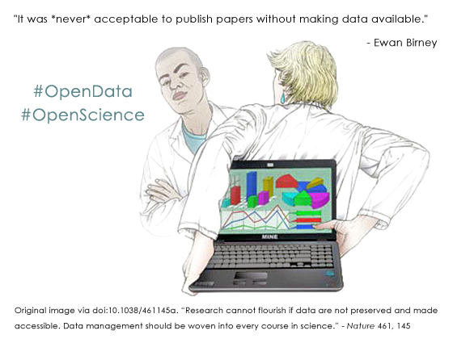
Why make data available?

Slide 3
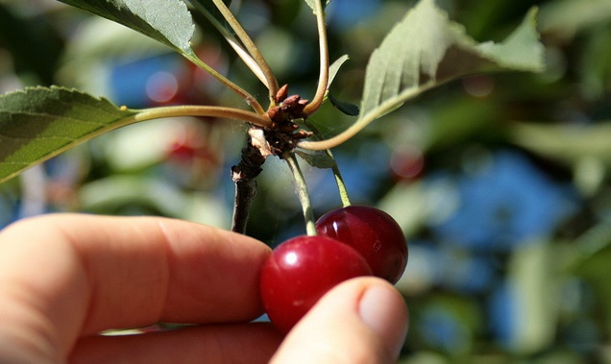
Selecting data

Slide 4

What must be shared?
The ORD pilot applies primarily to the data needed to validate the results presented in scientific publications. Other data can also be provided by the beneficiaries on a voluntary basis, as stated in their Data Management Plans.
H2020 Programme Guidelines on FAIR Data Management
- July 2016
Notes:
What counts depends on data’s value for purposes it has served or may serve, so consider these as first step.

Slide 5
What data carries value?
Indicators that data have value
Quality of the data and its description
  complete, accurate, reliable, valid, representative etc
Demand high
  known users, integration potential, reputation, recommendation, appeal
Replication difficulty
  difficult, costly, or impossible to reproduce
Low barriers
  legal/ ethical, copyright non-restrictive terms and conditions
Rarity
  unique copy or other copies at risk
Which related material does data depend on for its value?

Slide 6
e.g. High Energy Physics community
Levels of data to preserve | Reuse purpose
Additional documentation (e.g. wikis, news forums) | Publication-related information search
Data in a simplified format | Outreach, simple training analyses
Analysis level software and the data format | Full scientific analysis based on existing reconstruction
Reconstruction and simulation software and basic level data | Full potential of the experimental data
Adapted from: DPHEP Study Group: Towards a Global Effort for Sustainable Data Preservation in High Energy Physics, May 2012 . http://arxiv.org/abs/1205.4667

Slide 7

What can’t be shared?
Sensitive personal data
Data with IP or Copyright restrictions
Data that is too large to deliver over the network
Physical data
Notes:
Copyright restrictions can be particularly complicated when data has been aggregated or reused.

Slide 8
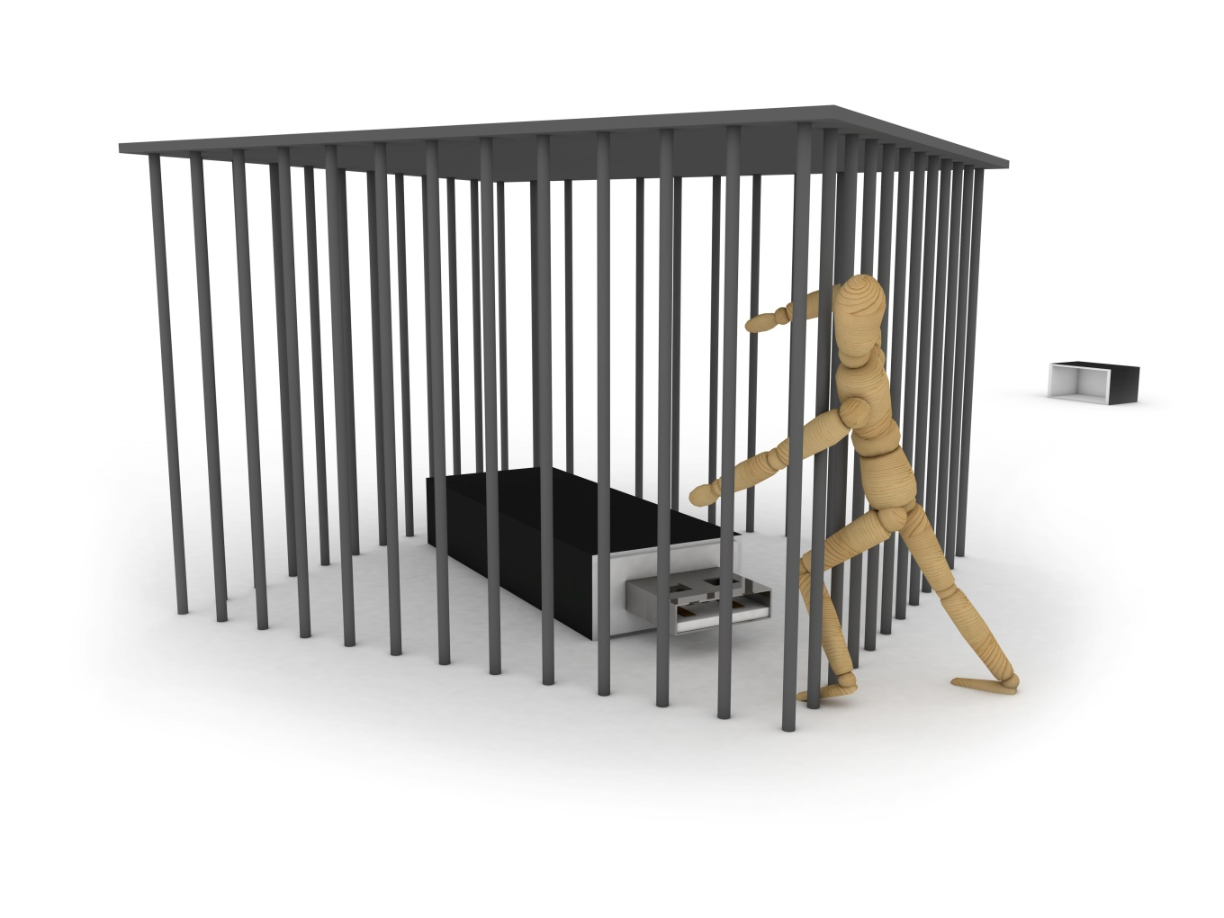
But…
It must be preserved
It should be visible
It may be accessible under certain conditions

Slide 9

Ensuring data is reusable

Slide 10

Data description - metadata
Citable
Findable
Re-usable
Notes:
Documentation and metadata are essentially descriptive information about the information contained in a dataset. There should be good documentation at the study level, for example a description of the research methodology that created the data – [the best metadata the data can have is the publication it supports] or a data paper. There should also be documentation at the file, item and variable level suitable so that someone reusing the data can understand it – this could be ensuring that excel spreadsheets have sensible row and column descriptions or that a document is included with the dataset which properly explains any abbreviations used.

Slide 11
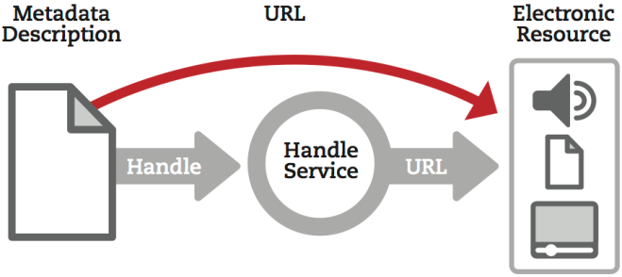
Ensure the data can be found
Get a persistent identifier – e.g. DataCite DOI
Notes:
The likely home of an electronic research data resource attached to a persistent identifier is a data repository (exceptions being resources not available over the web which have a PI attached to a metadata record – physical resource, cumbersomely large dataset etc.)

Slide 12
Linking and citation
Linking open data to publications increases citations
Want evidence?
  Alter, Pienta, Lyle – 240%, social sciences *
  Piwowar, Vision – 9% (microarray data)†
  Henneken, Accomazzi – 20% (astronomy) #
# Edwin Henneken, Alberto Accomazzi, (2011) Linking to Data - Effect on Citation Rates in Astronomy. http://arxiv.org/abs/1111.3618
* Amy Pienta, George Alter, Jared Lyle, (2010) The Enduring Value of Social Science Research: The Use and Reuse of Primary Research Data.
http://hdl.handle.net/2027.42/78307
† Piwowar H, Vision TJ. (2013) Data reuse & the open data citation advantage. PeerJ PrePrints 1:e1v1 http://dx.doi.org/10.7287/peerj.preprints.1v1

Slide 13

Ensure it can be used appropriately
Funders usually require datasets to carry information on access and any restrictions or conditions that apply

Slide 14

Ensuring the utility of the data
The what, why and how data creation must be understood
Data dictionaries
Columns/rows labelled
Variable ranges defined
Notes:
Ensuring that other researchers can understand and effectively reuse data that they access online without the help of the data’s creator is a more complicated task and requires a greater investment of effort to do successfully.

Slide 15
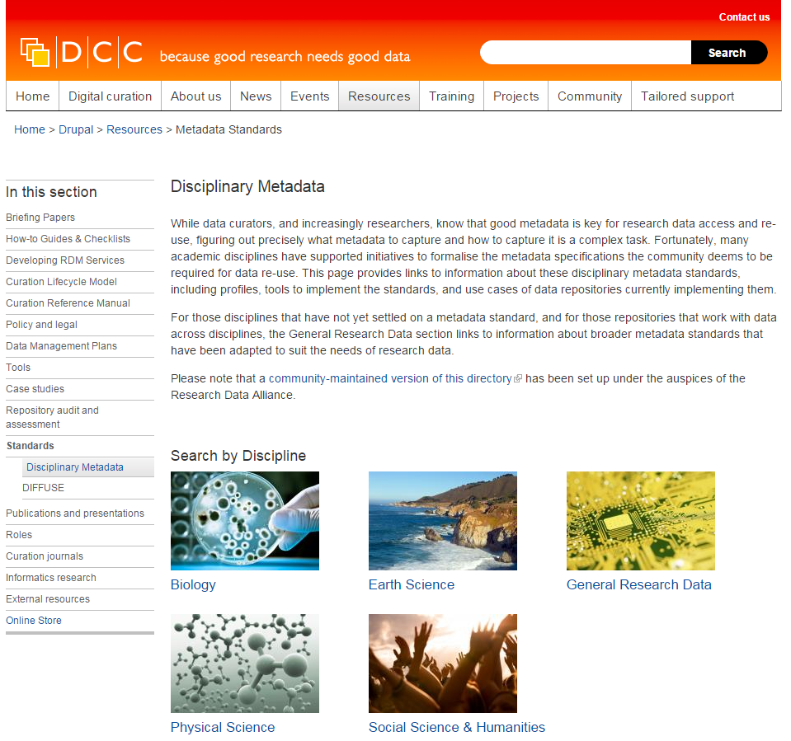
DCC metadata catalogue
The catalogue lists:
Metadata standards
Profiles
Use cases
Tools
http://www.dcc.ac.uk/drupal/resources/metadata-standards

Slide 16
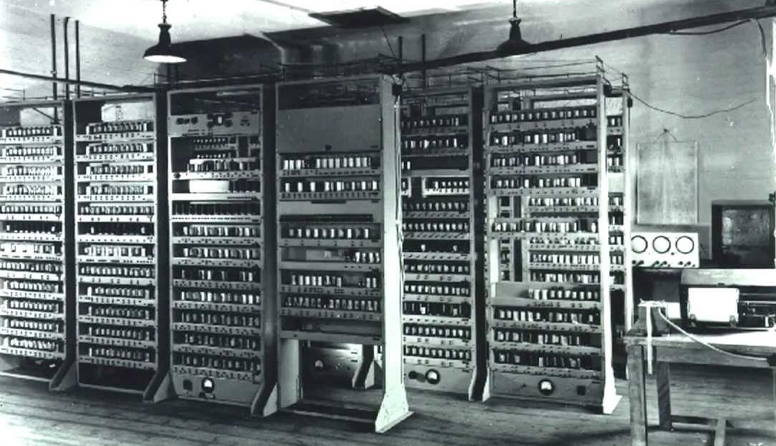
Now the where…

Slide 17

Options for sharing open data
Domain repository
General repository – Zenodo, Figshare, Dryad
Institutional repository
Journal supplementary material
Departmental web page
Notes:
Domain best
General – need to ensure it’s suitable for your use
Institutional – will keep data of low value or data with no other home but may not ensure targeted visibility
Journal – fulfils journal requirements but does not offer repo functionality or longevity required by funders
Web page – may target domain academics and allow manipulation of data and support for living datasets. Does not have citability, longevity or engender user trust that the resource is the same as the one described in publications.

Slide 18
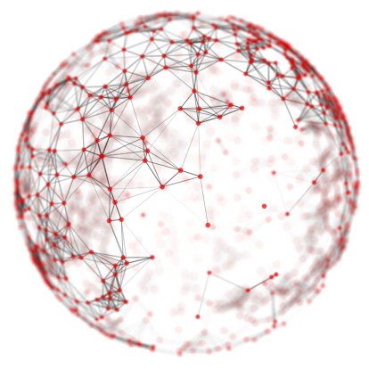
Depositing in multiple locations
A single location may not provide all that is needed
Niche disciplinary repositories may not offer guaranteed longevity
IR may hold prestige datasets
  Is it the repository of last resort?

Slide 19
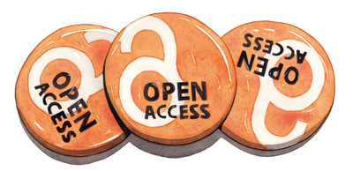
Repository selection

Slide 20

A conversation with peers
There may be an accepted repository used by peers or required by funders
Multidisciplinary studies may not have an obvious home
Data types and volumes will impact on decision

Slide 21
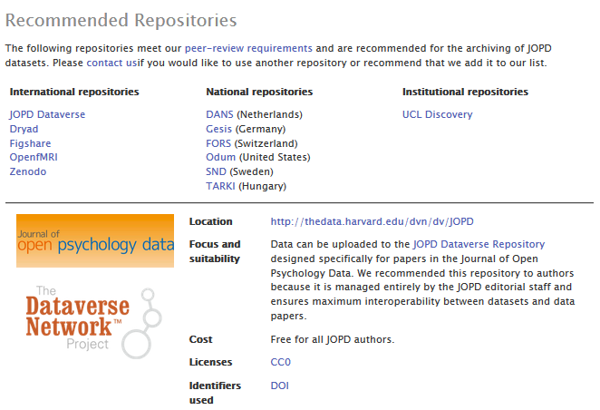
Journal’s guidance
Journal of Open Psychology Data

Slide 22
Finding external repositories
General directories
  Re3data.org
Domain specific directories
  E.g. Biosharing.org
Data journal recommendations
  See U of Edinburgh’s regularly updated list here:
  https://www.wiki.ed.ac.uk/display/datashare/Sources+of+dataset+peer+review
Funding body recommendations
  E.g. European Research Council
  https://erc.europa.eu/funding-and-grants/managing-project/open-access

Slide 23

Finding a repository
Lists over 1500 data repositories
Icons for ease of assessment
Supported by DataCite

Slide 24

DCC guidelines - repositories
Is the repository reputable?
Will it accept the data you want to deposit?
Will data be safe in legal terms?
Will the repository sustain data value?
Will the repository support analysis and track data usage?
Notes:
Will the data be citable? – Is a DOI provided

Slide 25


Any questions?
Jonathan Rans
J.Rans@ed.ac.uk
@JNRans
Images
Handles: https://www.clarin.eu/sites/default/files/handles.png
Cherries from: http://www.tomrand.net
Whispers from: http://www.manningcommunitynews.com/
Open access badges Jim Spencer from www.nature.com
Closed data from: http://www.gsma.com

